Slide 1
SC School Board’s Association
Cindy Van Buren, Ph.D.
Division of School Effectiveness
September 5, 2014

Slide 2
Division of School Effectiveness
Office of Educator Services – Mary Hipp
Office of Instructional Practices and Evaluations – Briana Timmerman
Office of School Leadership – Bruce Moseley
Office of School Transformation – Jennifer Morrison
Office of Virtual Education – Bradley Mitchell

Slide 3
Expanded Educator Evaluation System Guidelines
http://ed.sc.gov/agency/se/Educator-Evaluation/
Preamble explaining intent and philosophy of teacher professional growth
Organized by requirements of ESEA waiver (to prevent restrictions of NCLB)

Slide 4
Principal evaluation
Current PADEPP Standards 1-9 (50%)
School-wide student growth measures (50%)

Slide 5
Teacher Evaluation
Rubric-based Observations and professional practice (50%)
Student growth over school year (30%)
Classroom Value-add (tested grades /subjects)
Student Learning Objectives (non-tested grades / subjects)
District Choice (20%)

Slide 6
Student Learning Objectives (SLOs)
Locally created standards-based student growth target
May be school or district-wide or individual for each teacher
Specific, Measureable, Aspirational but Realistic, Time-specific
Uses at least two time periods per student (beginning/end of school year), more data points are better

Slide 7
Types of Value-Added
Classroom value-added
The average growth of all tested students for a given teacher
School-wide value-added – OPTIONAL
The average growth of all the state-tested students in a school.

Slide 8
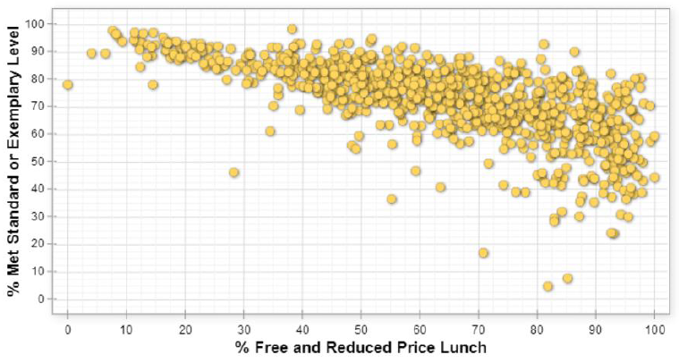
Achievement is affected by demographics
Notes:
SLOWLY explain graph.
Each dot is a SC school.
Achievement on left vertical axis as represented by % of students at that school who were “met” or “exemplary” on the PASS exam in grades 3-8 or HS EOC exams
% of students at that school who were eligible for free and reduced lunch in on horizontal axis
So affluent schools on the left side of the graph and impoverised schools on the right hand side.
Note the downward slope of the trend, if you are a high poverty school, you are more likely to have poor performance.
In contrast, no affluent schools scored less than 75% proficient. There are high-achieving, high poverty schools (indicate those on upper right), but if you are a low performing schools, there is a much higher chance that you are also high poverty.

Slide 9
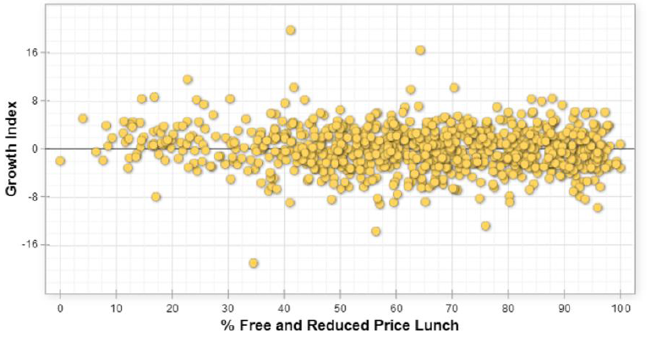
Value-Add Measures growth rather than achievement
Grew more than expected
0 = students grew the expected amount
Grew less than expected
Notes:
This graph is the same as the others in that each dot is a school using the same state-assessment data.
What is different is vertical axis is now Growth Index – similar to normal curve equivalents
Means that if you ranked all the students in the state by how they scored on statewide test in a given year and then compared how any given child’s ranking changed over time. Namely if a student had the equivalent of a 30% in grade 3 and stayed at the 30% in grade 4, then they would be right here on this black line.
zero = expected 1 yrs growth. Above the line means child learned MORE than expected, below means learned LESS than expected.
The black line – the expected years growth
So in contrast to achievement, more affluent schools are not any more or less likely than high-poverty schools to have greater growth. No positive or negative relationship between these two measures

Slide 10
What is Value-added?
Actual achievement
Value-added by that teacher
Expected achievement
2012 achievement
2013 achievement
References: Meyer & Dokumaci (2009); Wiley (2006)
Notes:
A statistical method for calculating the expected growth a student should make from a pre-test to a post-test or from one year’s high-stakes test to the next year’s and comparing that to the growth they actually do make.
An effective teacher is one who enacts the intended curriculum in a manner that ensures his/her students grow at least one grade level per academic year.
A teacher with high-value-add is one who helps her students CLOSE their achievement gap or grow beyond expectations.
A low-value add teacher, the gap WIDENS for her students.

Slide 11
Gain
Average Expected Growth – Average Actual Growth
So if the gain metric is zero, students met expected growth targets.

Slide 12
How does this play out in the classroom?
Mr. Sterling has an average class.
Average score of class
Actual = Expected Value-added score = 3
50% of his class scored as “proficient”
On average, his class made the expected amount of growth.
2011
2012
Notes:
With half of his students making better than expected growth and the other half making less than projected growth, his students’ actual growth is close to expected growth.

Slide 13
How does this play out in the classroom?
Ms. Draper has Honors students.
Average score of class
Expected
Value added score < 3
Actual
95% of her students scored “proficient”
BUT Only 5% made expected growth.
2011
2012
Notes:
Though her students’ achievement was high, her value-added score is low because her students’ performance was lower than expected.

Slide 14
How does this play out in the classroom?
Ms. Olsen is in a struggling school.
Average score of class
Actual
Value-added score >3
Only 5% of her students scored as “proficient”
But 95% made larger gains than expected.
Expected
2011
2012
Notes:
Though her students’ achievement was low, her value-added score is high because her students’ performance was better than projected.

Slide 15
VA 5
VA 4
VA 3
More than expected growth, Value-add score is 4 or 5
Expected growth = 3
Scores
VA 2
Less than expected growth, Value-add score is 1or 2
VA 1
Less than expected growth, Value-add score is 1or 2
Time
Notes:
Ms. Olson = above average
Mr. Sterling = average
Ms. Draper = below average
But how much they improve beyond the expectations
So using value-add methods means a strong teacher is rewarded for staying in a struggling school.

Slide 16
Value-added is associated with positive long-term student outcomes:
Improved college attendance—A series of high-value-added teachers may double or even triple college attendance rates.
Higher salaries in adulthood—Having one high-value-added teacher is associated with an additional $50K in lifetime earnings per student ($1.5 million for class of 30 students).
Reference: Chetty, Friedman, & Rockoff (2011)

Slide 17
References
Boyd, D., Grossman, P., Lankford, H., Loeb, S., & Wyckoff, J. (2008). Teacher preparation and student achievement (NBER Working Paper Series 14314). Cambridge, MA: National Bureau of Economic Research.
Chetty, R., Friedman, J. N., & Rockoff, J. E. (2011). The long-term impacts of teachers: Teacher value-added and student outcomes in adulthood (NBER Working Paper Series 17699). Cambridge, MA: National Bureau of Economic Research.
Clotfelter, C. T., Ladd, H. F., & Vigdor, J. L. (2007). Teacher credentials and student achievement in high school: A cross-subject analysis with student fixed effects (NBER Working Paper Series 13617). Cambridge, MA: National Bureau of Economic Research.
Goldhaber, D. D., & Brewer, D. J. (1996). Why don’t schools and teachers seem to matter? Assessing the impact of unobservables on educational productivity. Journal of Human Resources, 32 (3), 505–520.
Gordon, R., Kane, T., & Staiger, D. O. (2006). Identifying effective teachers using performance on the job (Hamilton Project Discussion Paper). Washington, DC: The Brookings Institution.
Harris, D. N., & Sass, T. R. (2009). The effects of NBPTS­certified teachers on student achievement. Washington, DC: National Center for Analysis of Longitudinal Data in Education Research.
Hershberg, T., Simon, V. A., & Kruger, B. L. (2004). The revelations of value-added. The School Administrator, 61, 10–14.
Koretz, D. (2008). A measured approach. American Educator, Fall, 18–39.
Meyer, R. & Dokumaci, E. (2009). Value-added models and the next generation of assessments. Austin, TX: Center for K-12 Assessment & Performance Management.
National Association of State Boards of Education (NASBE, 2005). Evaluating value-added: Findings and recommendations from the NASBE Study Group on value-added assessments. Alexandria, VA: Author.
Wiley, E. W. (2006). A practitioner’s guide to value-added assessment. Tempe, AZ: Arizona State University.

Slide 18
Questions/Discussion

